Slide 1


Used Car Price Prediction Model
BDM 3014 Project Proposal Presentation
By BIG dATA ANALYTICS – Second Semester (Group 2)
11 March 2024

Slide 2
Overview
Introduction
Problem Statement
Why Should the Consumer Apply Our Model?
Key Components of the Project
Project Outcome

Slide 3
Introduction
How the Automotive Industry Domain Works
What motivated the creation of our model?

Slide 4
Problem Statement
Challenges Our Model Aims To Address
How and to whom our Model Will Address?

Slide 5
WHY SHOULD The consumer APPLY OUR MODEL??
Customised Model
Continuous Learning
Transparency
Integration
Cost-Effective Model

Slide 6
KEY Components OF THE PROJECT
Data Collection/Gathering Phase
The dataset is sourced from Kaggle
It consists of 423,857 rows and 25 features
Model Building Phase
Data Preprocessing
Feature Engineering
Model Training
Model Evaluation and Validation
User Interface (UI) Module

Slide 7
KEY Components OF THE PROJECT
Data Preprocessing
Feature Engineering
Removing outliers
Handling missing values
Handling duplicates
Encoding categorical variables
Scaling numerical features
Handling highly correlated features
Model Training
Model Evaluation and Validation
Splitting the dataset
Feature scaling
Hyperparameter tuning
Using metrics
Achieving a high accuracy rate
Prediction

Slide 8
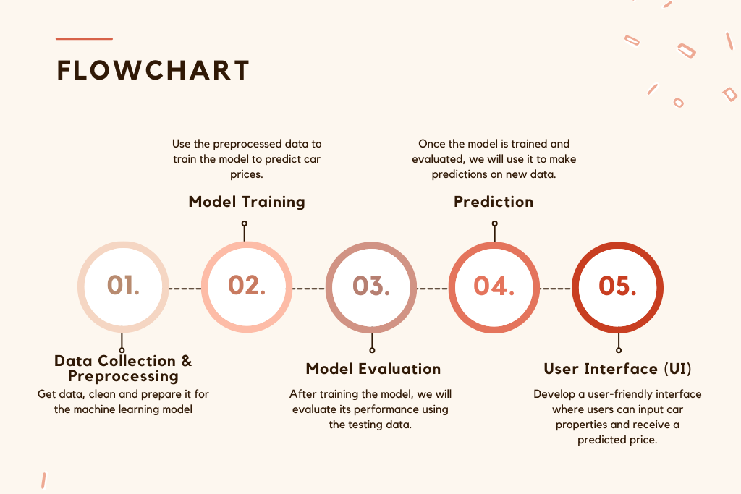
Fig: Flowchart of Analytical/Mathematical modules

Slide 9
Project Outcome
Informed Buying and Selling
Price Transparency
Fair Pricing
Reduced Information Asymmetry
Market Insights
Enhanced User Experience
User Feedback and Improvement

Slide 10

Thank You
1 Aljesh Basnet
2 Bharat Dhungana
3 Bijay Adhikari
4 Lateef Taofeek
5 Oluwatimileyin Oyedele
6 Satish Kandel
7 Shishir Dhakal

